Slide 1

GROUP 10
DETECTING HEALTHCARE FRAUD
Ambarish Narayan, Bhuvana Chandrika Kothapalli, Meenakshi Sundaram,
Meghavi Singhaniya, Vaibhav Nagar, Vaishnavi Ganesh
,

Slide 2


AGENDA
Problem Statement
What is the issue?
Who is potentially involved?
What data are we using?
What is the traditional method?
What is our strategy?
What did we find?

Slide 3

Problem statement
The project aims to predict potentially fraudulent providers by analyzing their filed claims
Identify key variables crucial for detecting suspicious behavior among providers.

Slide 4

What is the issue?
Medical fraud, including billing for services not provided and duplicating claims, is a pervasive issue in healthcare systems globally.
It involves submitting false claims to insurers or government programs, leading to significant financial losses, potential harm to patients, and erosion of trust in the healthcare system.
Instances of fraudulent billing can result in inflated healthcare expenses, incorrect medical records, and diminished confidence in the quality of care provided.
Real-life incidents demonstrate the substantial impact of medical fraud, including billions of dollars in financial losses, legal repercussions for providers, and the need for robust detection and enforcement measures to safeguard against fraudulent activities.
Addressing medical fraud requires comprehensive strategies to promote transparency, accountability, and trust within the healthcare industry.

Slide 5
What is the issue? - Common fraudulent Activities
There are four main types of fraud that are majorly present in the healthcare sector:
Billing a service not actually provided
Submitting multiple claims for the same service
Misrepresenting the service provided
Overcharging for a service beyond what was provided

Slide 6





Who is potentially involved?
Providers
Attending Physicians
Operating Physicians
Beneficiaries

Slide 7
What data are we using?
Inpatient claims, Outpatient claims and Beneficiary details of each provider
Beneficiary
Inpatient
Outpatient
Beneficiary KYC details
Claims filed for those patients who are admitted in the hospitals
Claims filed for those patients who visit hospitals and not admitted in it.
138,556 records
9,551 records
125,842 records
Patient Demographics
. Claim ID . Provider . Operating Physician . Attending Physician . Diagnosis Code . Procedure Code .
. Claim ID . Provider . Operating Physician . Attending Physician . Diagnosis Code . Procedure Code .
. ID . DOB . DOD . Gender . Race .
Chronic Conditions
+ Provider ID + Potential Fraud (Y/N)

Slide 8

What data are we using?
71,030
BENEFECIARIES
#
4,852
PROVIDERS
of
36,461
ATTENDING PHYSICIANS
35,313
OPERATING PHYSICIANS

Slide 9

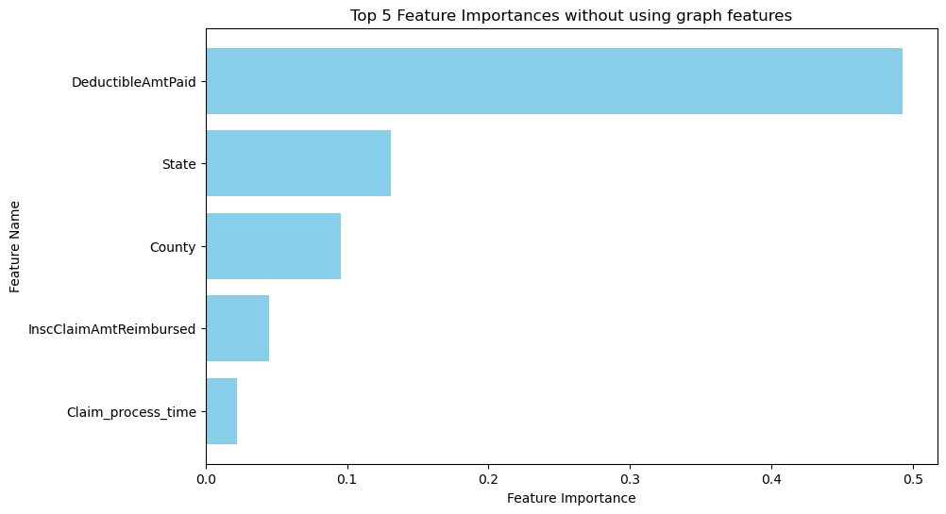
What is the traditional method?
1. Run classification models with the dataset having Potential Fraud / Not as the output variable
2. Select important features, perform feature engineering to improve accuracy by reducing overfitting possibilities
After using Random Forest and XG Boost methods, we found that the XG Boost model gave higher accuracy of about 71%
Top 5 features involve beneficiary demographics and claim specific characteristics rather than provider characteristics
Since we are trying to look at “PROVIDER FRAUD” – we need to account for the network characteristics in healthcare system

Slide 10

what is our strategy?
Identifying fraud by increased interpretability using graphs to review the peer network
Form a Network of Providers, Beneficiaries, APs and OPs
Find degree, closeness, eigen vector centrality
Include graph features in the model to improve accuracy

Slide 11

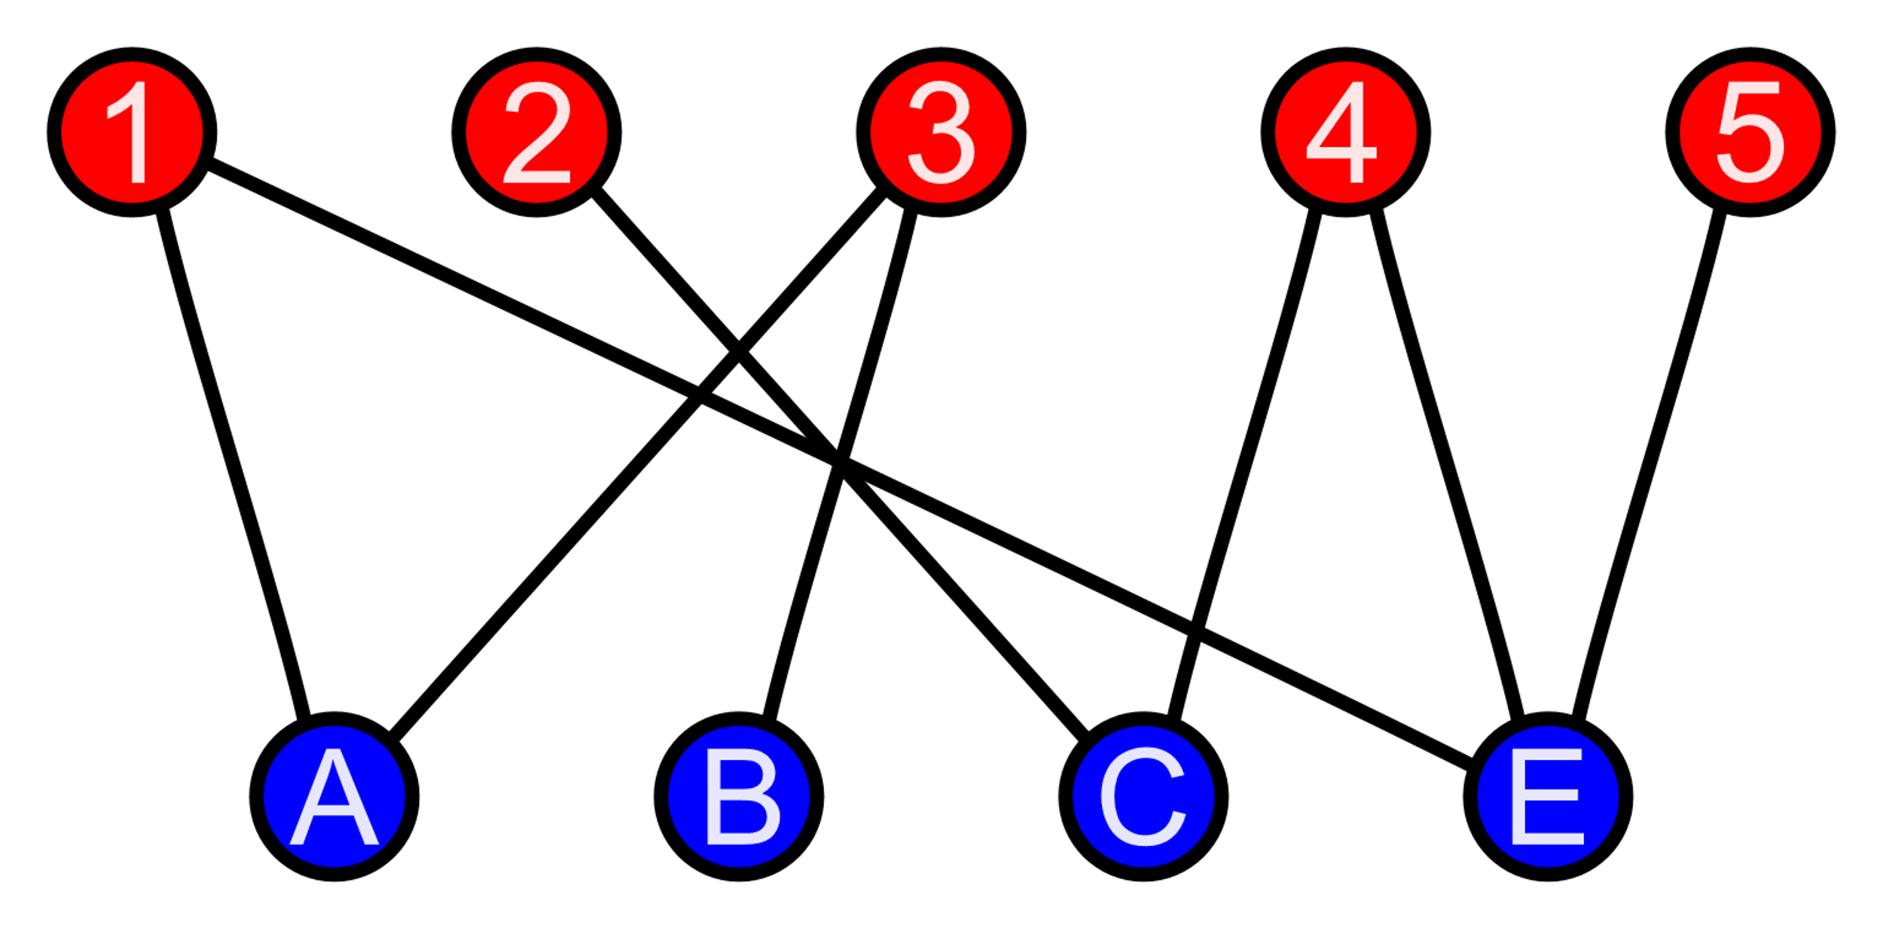
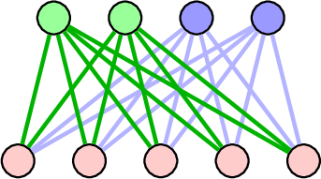
INCLUSION OF GRAPH FEATURES
provider
providers
Attending physicians
operating physicians
Attending physician
Operating physician
beneficiaries
beneficiary
beneficiaries
Features used from formed networks
Degree
Closeness centrality
Eigen vector centrality
Bi-rank
Notes:
Whoever is explaining this slide – please explain why would we prefer Birank over Pagerank – read literature

Slide 12
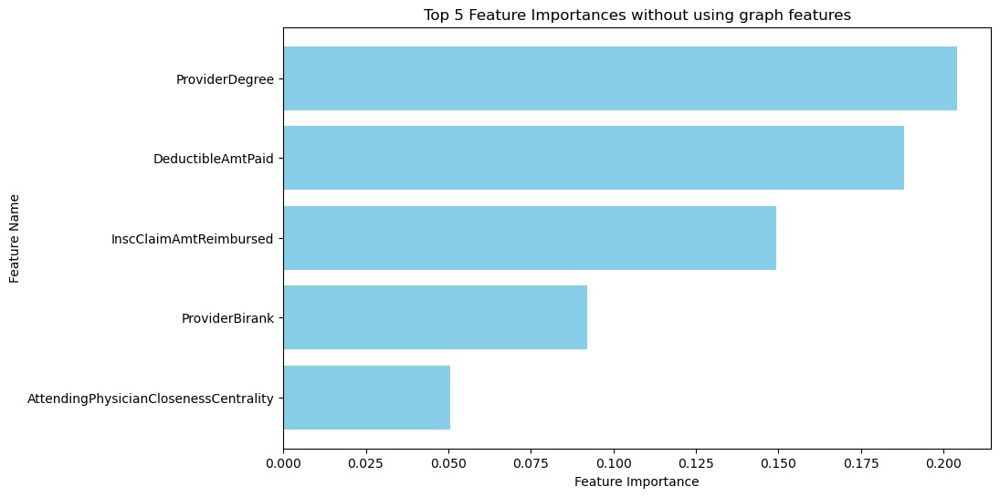
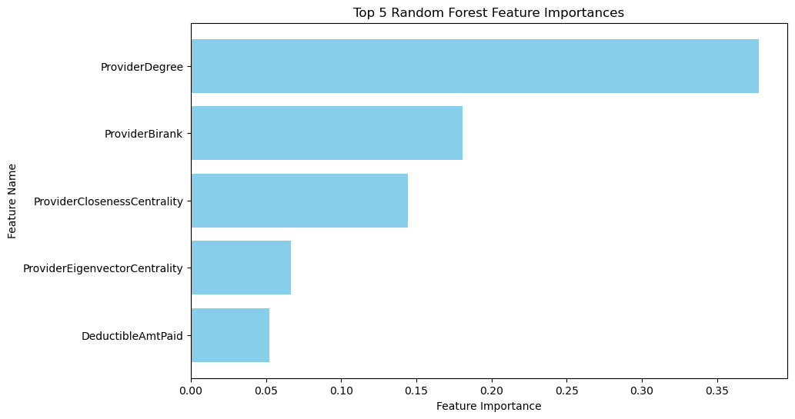
Adding the features as mentioned
1. In addition to the features from the dataset, add the graph features (degree, closeness, eigenvector, birank) to the dataset
2. Run the classification model using original + graph features and choose the best features that give the highest accuracy
Random forest Model gave accuracy about 83%
XG Boost model gave higher accuracy of about 92%
We see that both Attending Physician – Beneficiary and Provider – Beneficiary graph metrics are covered in the Random Forest method, whereas in XG boost, the Provider – Beneficiary metrics have more importance

Slide 13
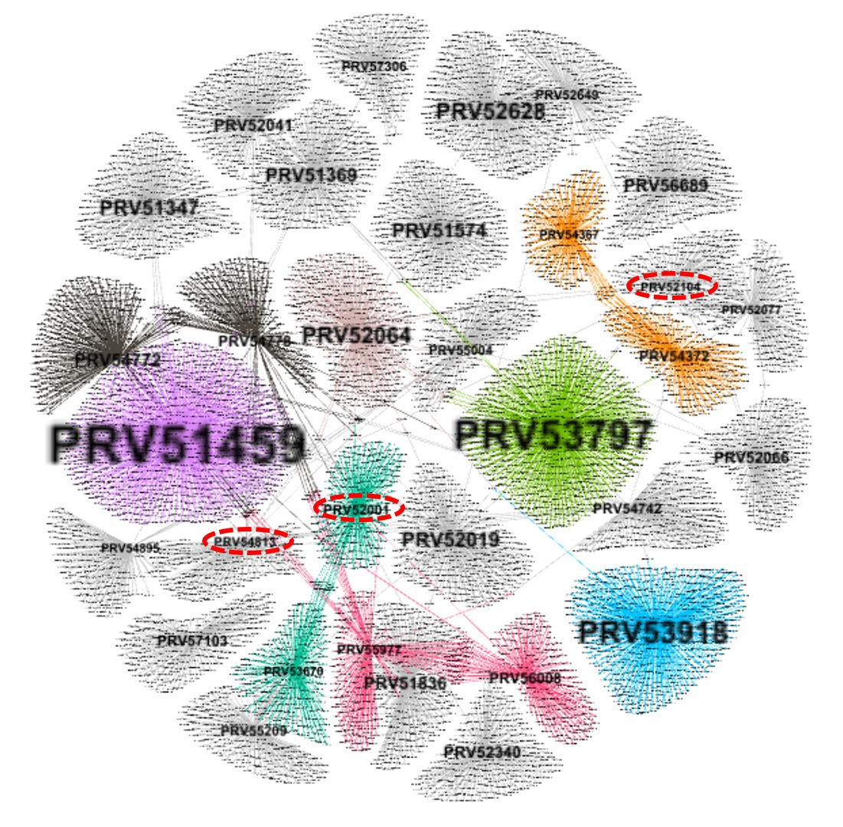
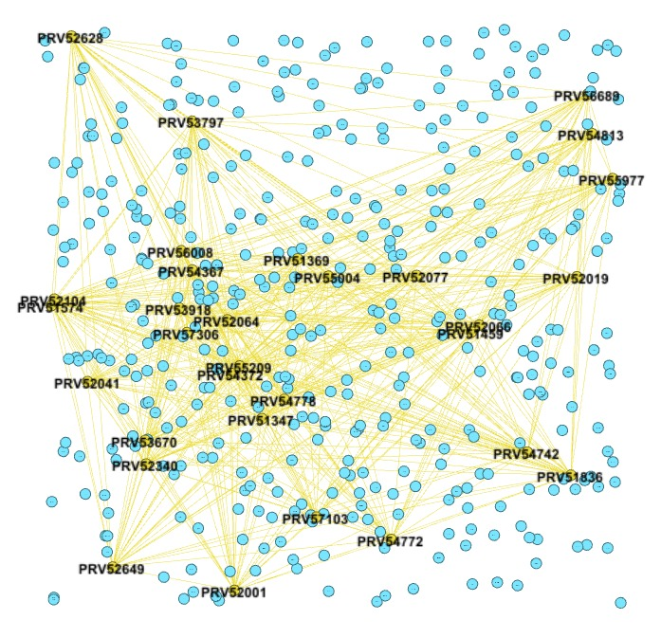
NETWORK ANALYSIS
Case 1: Attending Physician is same as Operating Physician
Hypothesis: If the attending physician are same as operating physician for more than 15 times for a provider – the network is more likely to be able to commit a fraud.
Provider – Beneficiary Network
Unipartite Network
Provider Degree > 150 out of
Repeated AP equals OP cases > 15
- False Positives
Results:
Amongst the 31 providers with degree > 150, 28 out of 31 - Actually, Fraudulent
90% Identification accuracy
Results:
445 providers with repeat AP equals OP cases > 15.
Labeled nodes denote providers with a degree > 150, totaling 31 central nodes flagged as suspicious in the LHS provider-beneficiary network.
Green nodes are interconnected due to their common factor (degree > 150), while red nodes, not meeting this criterion, remain disconnected.
Control Conditions:
Frequency of repetition > 15

Slide 14
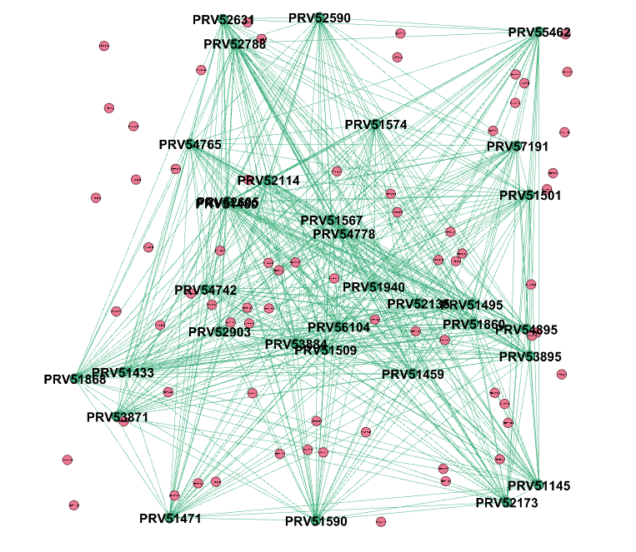
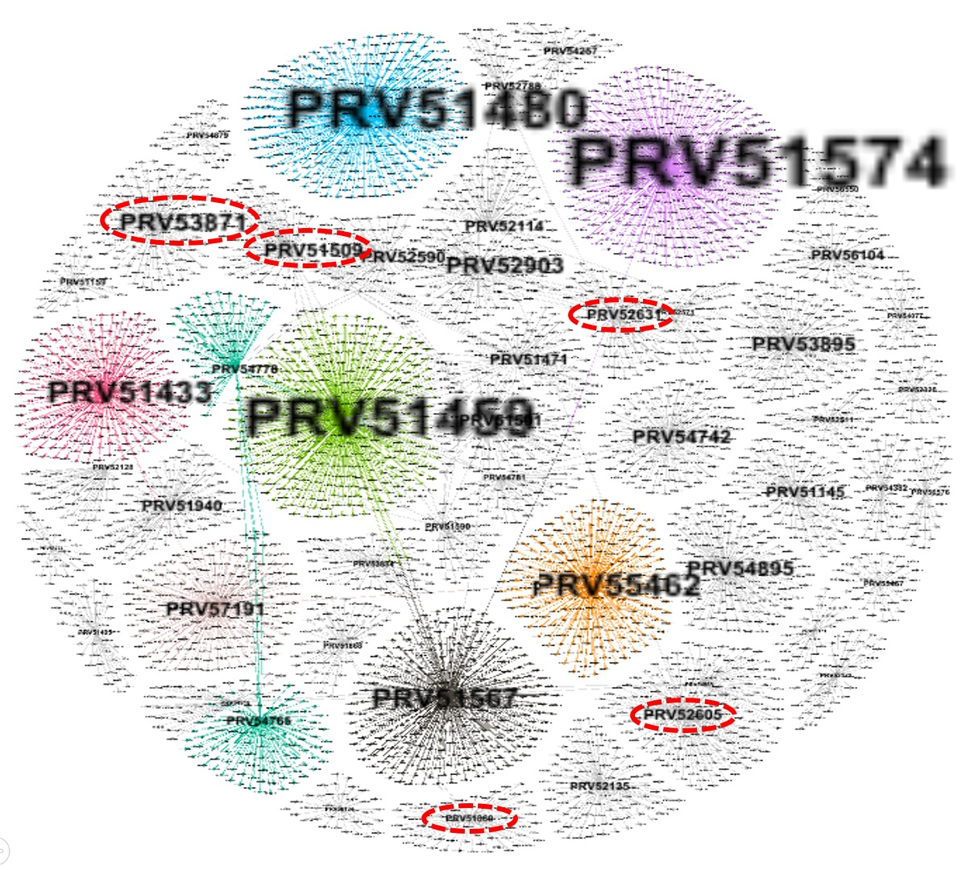
NETWORK ANALYSIS
Case 2: The same AP-OP pair repeats for more than 50 times
Hypothesis: If the pair repeats for more than 50 times, it indicates a potential fraud opportunity within the network.
Provider – Beneficiary Network
Unipartite Network
Provider Degree>40” out of
Repeated (AP,OP) pairs with frequency > 15
- False Positives
Results:
101 providers with repeated AP-OP pairs > 15
Green nodes denote providers with degree > 40, totaling 32 central nodes flagged as suspicious in LHS analysis.
Blue nodes - providers flagged as fraudulent in both previous analyses.
Control Conditions:
AP-OP Pair repeats more than 50 times
Results:
28 out of 32 suspicious nodes with degree > 40 – Fraudulent
85% Identification accuracy

Slide 15
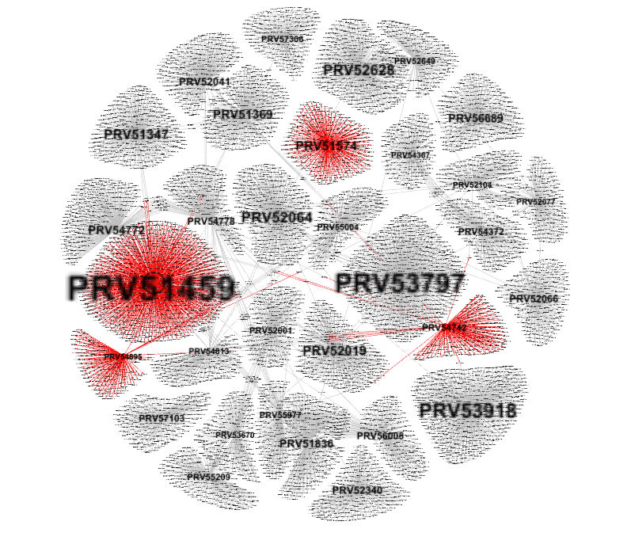
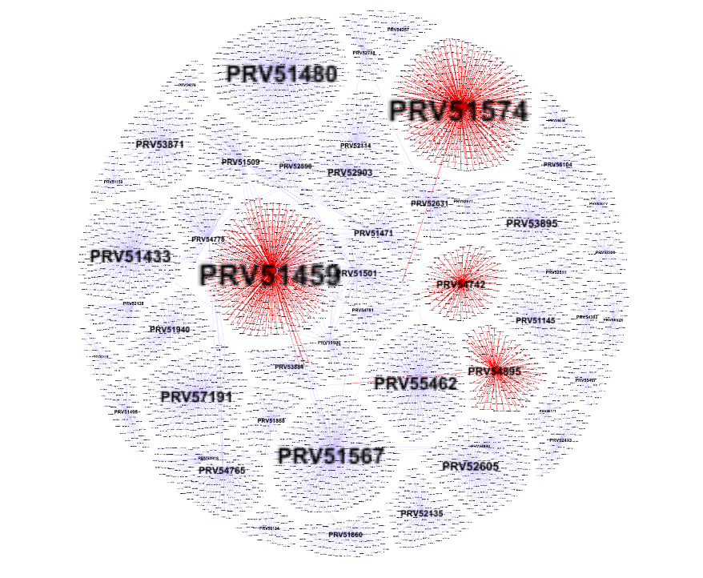
Repeatedly Flagged Providers...
Case 1 : Provider – Beneficiary Network
Case 2 : Provider – Beneficiary Network
For cases, where attending physician is same as operating physician for more than 15 times
For cases, where the same (AP,OP) pair repeats for more than 50 times

Slide 16
Repeatedly Flagged Providers...
PRV51459
Degree - 1049
Closeness Centrality - 0.195
Eigen Vector Centrality - 0.7063
Bi-Rank - 0.697
Degree: These providers have higher than average degree, indicating they treat more beneficiaries, which provides them greater opportunity to commit fraud
Closeness Centrality shows a similar behavior
Eigenvector Centrality - For PRV51459 we see the metric to be unusually high – Because beneficiaries for this provider are also connected to other potentially fraudulent providers with high scores indicating that these beneficiaries might be involved in defrauding the system
Bi-rank – Similar to above metric, the PRV51459 is the most influential given that it is connected to a lot of potentially fraud providers.
PRV51574
Degree - 571
Closeness Centrality - 0.170
Eigen Vector Centrality - 0.0003
Bi-Rank - 0.000167
PRV54895
Degree - 481
Closeness Centrality - 0.179
Eigen Vector Centrality - 0.0002
Bi-Rank - 0.00008
PRV54742
Degree - 352
Closeness Centrality - 0.178
Eigen Vector Centrality - 0.00004
Bi-Rank - 0.00003
Average Values
Degree
20.7
Closeness Centrality
0.121
Eigen Vector Centrality
0.00023
Bi-rank
0.0002
Notes:
A high eigenvector score means that a node is connected to many nodes who themselves have high scores.
A "high bipartite rank" would typically indicate a bipartite graph that is more complex or dense in terms of its structure. This could imply that the graph has more connections or relationships between the two sets of vertices, or it could suggest that the graph represents a more intricate or interrelated system.

Slide 17
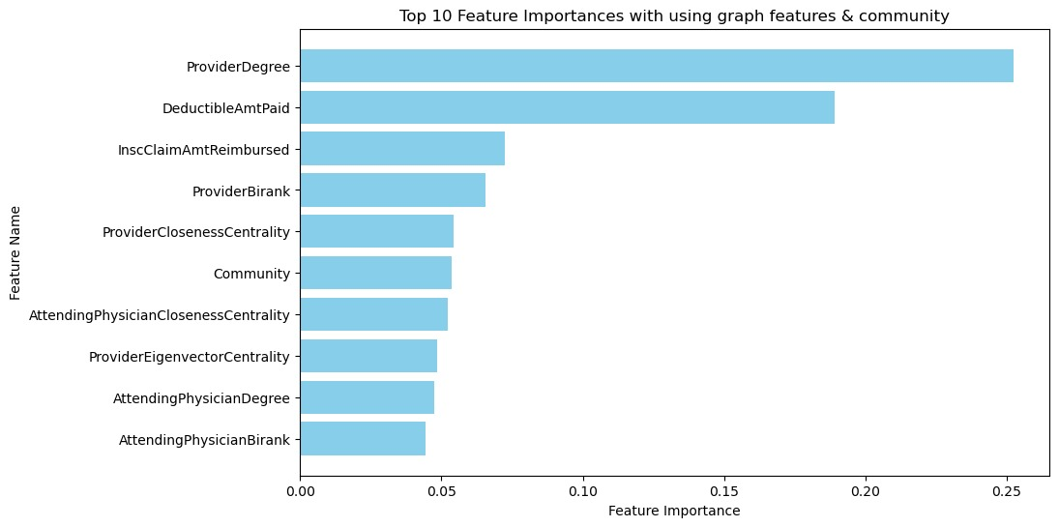
Adding Community detection features…
In addition to the graph features we also add community detection features to try and get a better accuracy.
After using Random Forest and XG Boost methods, we found that the XG Boost model gave higher accuracy of about 92%
We employed the Clauset-Newman-Moore greedy modularity maximization algorithm, specifically the 'greedy_modularity_communities' function, to detect communities within the network/graph structure.
Implements a greedy algorithm to identify communities within a graph by maximizing the modularity score. It iteratively merges communities based on the modularity measure until no further increase is possible or a stopping condition is met.
Community appeared as the 6th most important feature.
Though accuracy doesn’t increase right now but community being the 6th most important feature is indicative that with additional hyperparameter tuning or a better community detection algorithm we could see better results.

Slide 18
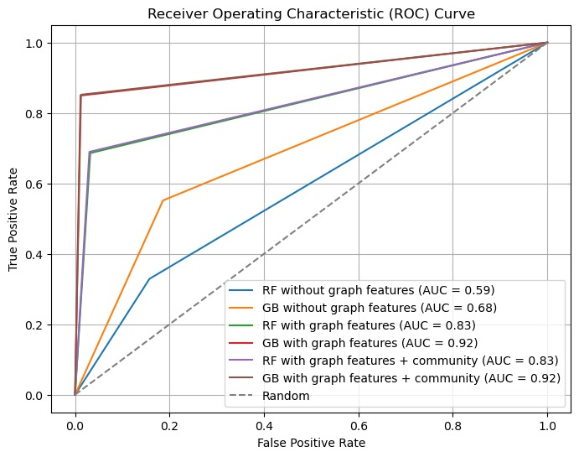
Comparative model performances
AUC: 0.68
Top Features: Claim amt reimbursed Deductible amt paid, Location
AUC: 0.92
Top Features: Provider degree centrality & Bi-rank
AUC: 0.92
Top Features: Provider degree centrality measures, community & Bi-rank
Basic
Features
+ Network
Features
+ Community

Slide 19

Going forward: Enhancing network Analysis
Incorporation of Advanced community detection Algorithms
- We could plan to integrate the Louvain, Leiden and Infomap algorithms into our analysis to leverage their advanced community detection capabilities.
- This could lead to an increased accuracy for our third method.
Exploration of Network Structures
- We could aim to explore clique and core structures within the graph to identify tightly-knit groups and central frameworks
- This approach could uncover pivotal patterns in provider-beneficiary interactions, potentially leading to breakthrough insights
Continued Network Analysis
- We could proceed with rigorous network analysis to enhance the accuracy of our predictive models
- The exploration of graph networks can be intensified to refine our understanding of complex relationships within the healthcare system

Slide 20

Thank you!

